Slide 1

7th Grade Math
Unit 6, Lesson 5 Converting Units of Volume Volume 1, pg. 256

Slide 2


Benchmark
MA.7.AR.3.3
Solve mathematical and real-world problems involving the conversion of units across different measurement systems.
volume 1, pg. 256

Slide 3
Integrated Mathematical Thinking and Reasoning Standards
MA.K12.MTR.3.1 Complete tasks with mathematical fluency.
volume 1, pg. 256

Slide 4

Learning Target
I can convert liquid measurements and volume across different measurement systems.
volume 1, pg. 256

Slide 5

Warm-Up
volume 1, pg. 257

Slide 6
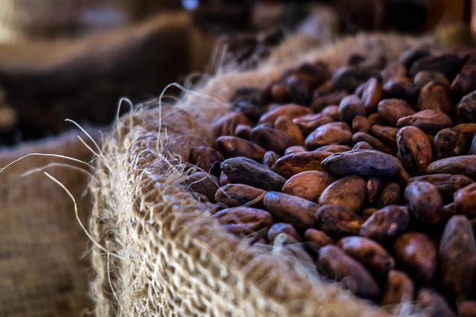
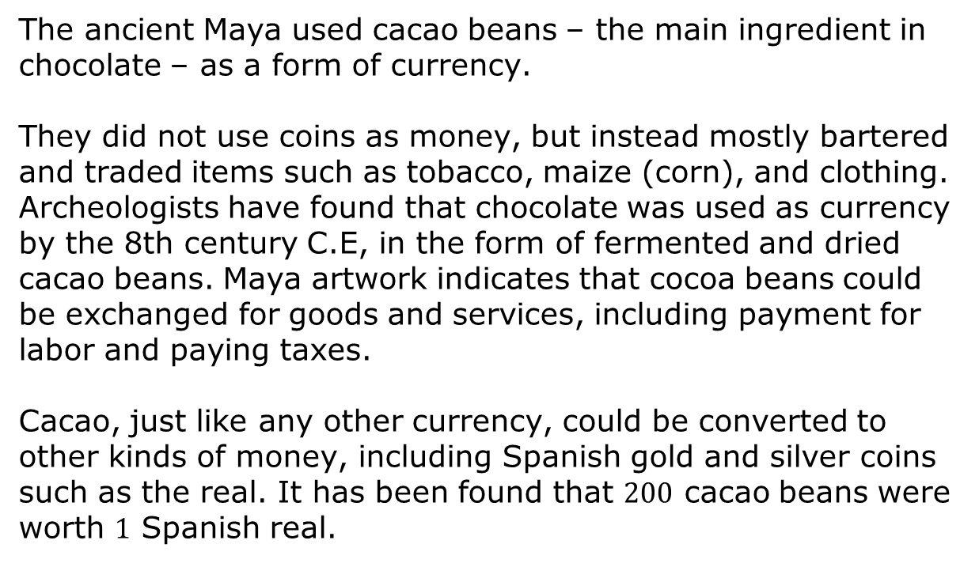
6.5.1 Warm-Up: Mayan Currency
The ancient Maya used cacao beans – the main ingredient in chocolate – as a form of currency.
They did not use coins as money, but instead mostly bartered and traded items such as tobacco, maize (corn), and clothing. Archeologists have found that chocolate was used as currency by the 8th century C.E, in the form of fermented and dried cacao beans. Maya artwork indicates that cocoa beans could be exchanged for goods and services, including payment for labor and paying taxes.
Cacao, just like any other currency, could be converted to other kinds of money, including Spanish gold and silver coins such as the real. It has been found that $200$ cacao beans were worth $1$ Spanish real.
volume 1, pg. 257

Slide 7

If $24,000$ cacao beans was worth $15$ pesos, what was the rate of cacao beans for $1$ peso?
How many pesos were equal to $1$ Spanish real?
volume 1, pg. 257

Slide 8

Activity
volume 1, pg. 257

Slide 9

6.5.2 Activity: Pouring Liquids to Find Conversion Rates
Each of us uses containers that have volume. Most of those containers are labeled with both U.S. customary measurements and liquid metric measurements.
List some U.S. customary measurements and liquid metric measurements.
volume 1, pg. 257

Slide 10
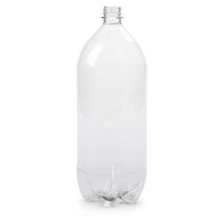
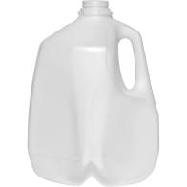
Many soft drinks come in 2-liter bottles, while milk is often sold by the gallon.
2-Liter Soda Bottle | 1 Gallon Milk Container
Which container do you think holds more liquid? Explain your reasoning.
volume 1, pg. 257

Slide 11
Both liters (L) and gallons (gal) are units used to measure liquid volume. Liters are units within the metric system, while gallons are part of the U.S. customary system.
volume 1, pg. 257

Slide 12

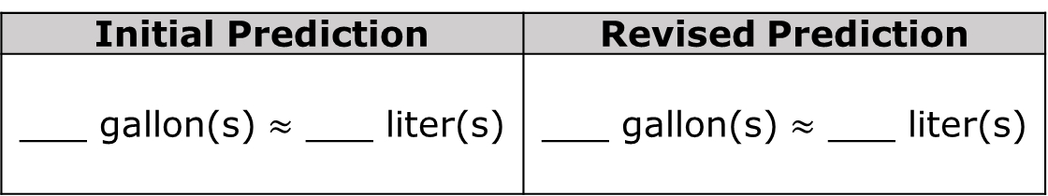
What do you predict is the relationship between liters and gallons based on the size of the containers? Write your prediction under the initial prediction heading in the table below.
Initial Prediction | Revised Prediction
___ gallon(s) $≈$ ___ liter(s) | ___ gallon(s) $≈$ ___ liter(s)
Watch the short video of liquid from one container being poured into the other.
volume 1, pg. 258

Slide 13
Based on your initial prediction and the amount of liquid in each container now, discuss the relationship between liters and gallons. Then, write a revised prediction in the table above.
Continue watching the remainder of the video.
volume 1, pg. 258

Slide 14
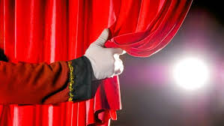
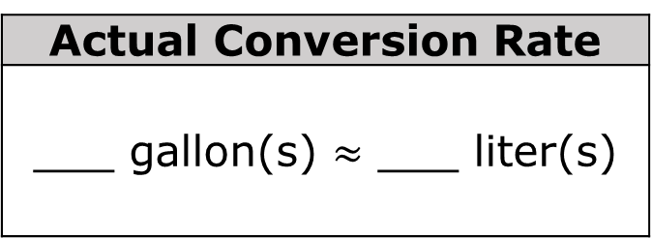
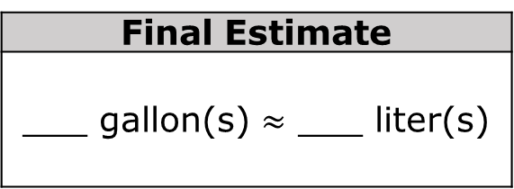
Based on the video, what is your final estimate for the relationship between liters and gallons?
Final Estimate
___ gallon(s) $≈$ ___ liter(s)
How close is your estimate to the actual conversion rate?
The big reveal…
Actual Conversion Rate
___ gallon(s) $≈$ ___ liter(s)
volume 1, pg. 258

Slide 15
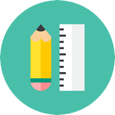
Try It
volume 1, pg. 259

Slide 16
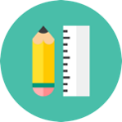
6.5.3 Try It: Converting Liquid Volume Measurements
Aleah is mixing concrete for a home-improvement project. According to the bag directions, she needs 6 gallons (gal) of water to mix the amount of concrete needed. The mixing bucket only has markings in liters (L). How many liters of water does she need to measure out for mixing the concrete? Round to the nearest tenth.
volume 1, pg. 259

Slide 17
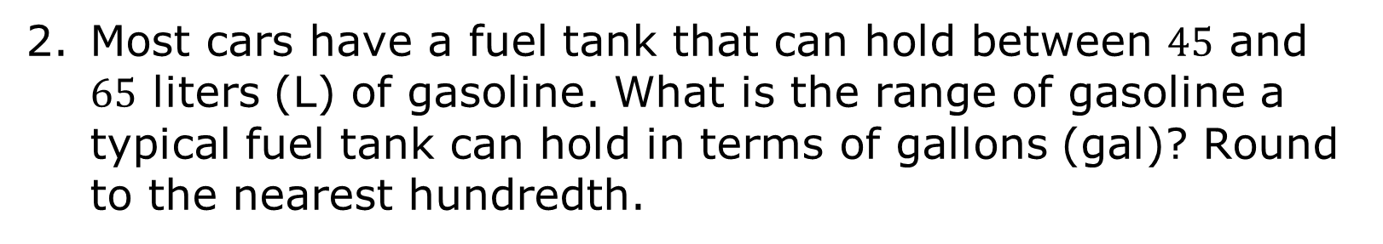
Most cars have a fuel tank that can hold between $45$ and $65$ liters (L) of gasoline. What is the range of gasoline a typical fuel tank can hold in terms of gallons (gal)? Round to the nearest hundredth.
volume 1, pg. 259

Slide 18

Guided Practice
volume 1, pg. 259

Slide 19

6.5.4 Guided Practice: Converting Liquid Volume Measurements
The units commonly used for liquid capacity within each system are shown, listed from smallest to largest.
U.S. Customary System | Metric System
fluid ounces (fl oz) cups (c) pints (p) quarts (qt) gallons (gal) | milliliters (mL) liters (L)
The tables below show the conversion rates for common units of liquid capacity in the U.S. customary and metric systems.
volume 1, pg. 259

Slide 20
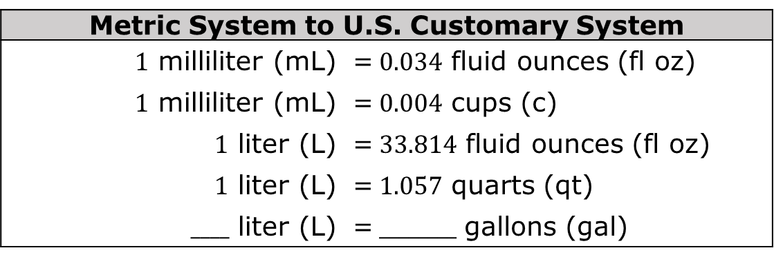
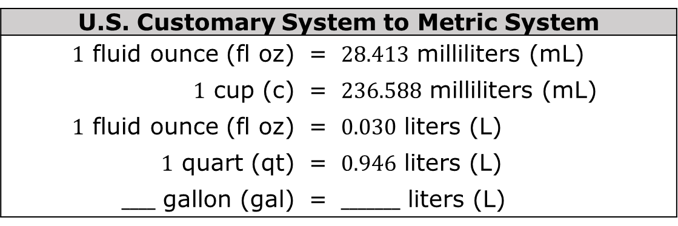
U.S. Customary System to Metric System
$1$ fluid ounce (fl oz) | = | $28.413$ milliliters (mL)
$1$ cup (c) | = | $236.588$ milliliters (mL)
$1$ fluid ounce (fl oz) | = | $0.030$ liters (L)
$1$ quart (qt) | = | $0.946$ liters (L)
$____$ gallon (gal) | = | $_______$ liters (L)
Metric System to U.S. Customary System
$1$ milliliter (mL) | = | $0.034$ fluid ounces (fl oz)
$1$ milliliter (mL) | = | $0.004$ cups (c)
$1$ liter (L) | = | $33.814$ fluid ounces (fl oz)
$1$ liter (L) | = | $1.057$ quarts (qt)
$____$ liter (L) | = | $________$ gallons (gal)
volume 1, pg. 259

Slide 21

Use the conversion rates to find each value below. Round to the nearest hundredth.
$240$ mL = ______ c
$100$ fl oz = ______ L
There are $100$ centiliters (cL) in a liter. How many centiliters are in $2.75$ quarts?
volume 1, pg. 260

Slide 22

Guided Instruction
volume 1, pg. 260

Slide 23

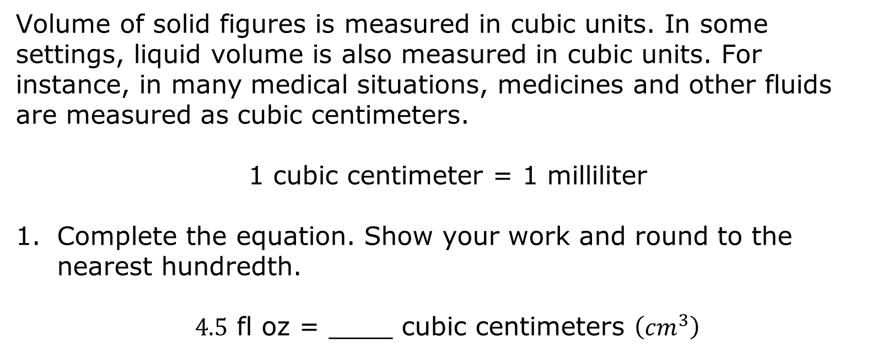
6.5.5 Guided Instruction: Cubic Units of Volume
Volume of solid figures is measured in cubic units. In some settings, liquid volume is also measured in cubic units. For instance, in many medical situations, medicines and other fluids are measured as cubic centimeters.
1 cubic centimeter = 1 milliliter
Complete the equation. Show your work and round to the nearest hundredth.
$4.5$ fl oz = ____ cubic centimeters $\left({cm}^{3}\right)$
volume 1, pg. 260

Slide 24



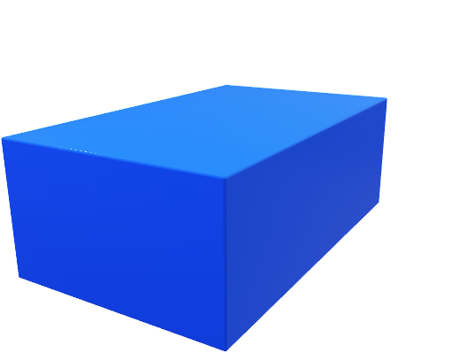
For solid volume, the conversion rates can be determined using the conversion rates for length.
$$x in$$
$$y in$$
There are two ways to find the volume of a rectangular prism in cubic centimeters when the prism’s side measurements are given in inches.
$$z in$$
Method 1 | Method 2
Convert each side length to centimeters and then calculate the volume of the figure in cubic centimeters. | Calculate the volume of the figure in cubic inches and then convert the volume to cubic centimeters.
volume 1, pg. 260

Slide 25
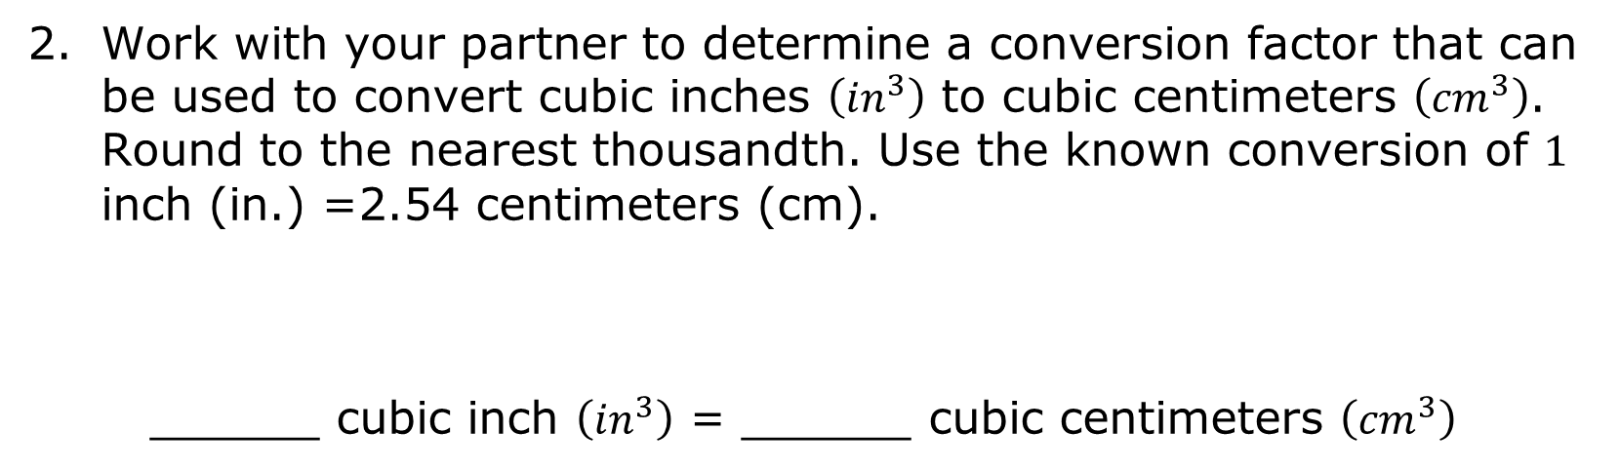
Work with your partner to determine a conversion factor that can be used to convert cubic inches $\left({in}^{3}\right)$ to cubic centimeters $\left({cm}^{3}\right)$. Round to the nearest thousandth. Use the known conversion of $1$ inch (in.) =2.54 centimeters (cm).
______ cubic inch $\left({in}^{3}\right)$ = ______ cubic centimeters $\left({cm}^{3}\right)$
volume 1, pg. 261

Slide 26



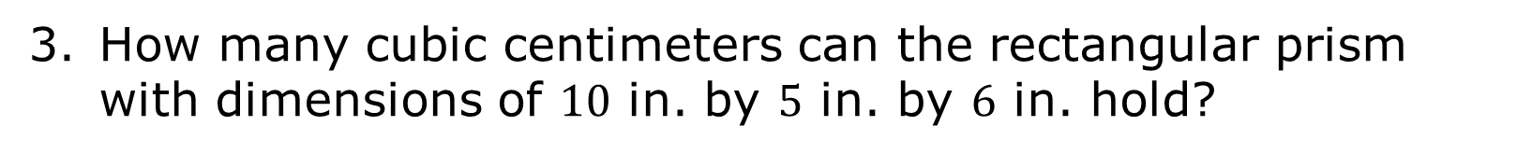
How many cubic centimeters can the rectangular prism with dimensions of $10$ in. by $5$ in. by $6$ in. hold?
$6$ in.
$5$ in.
$10$ in.
volume 1, pg. 261

Slide 27

Your Turn
volume 1, pg. 261

Slide 28

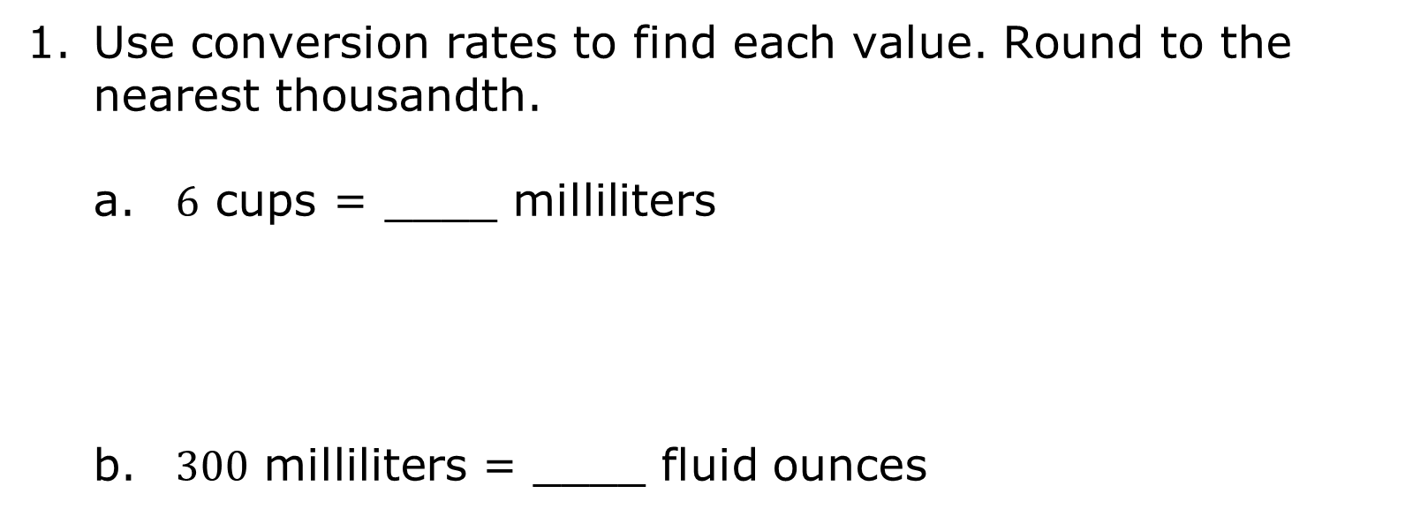
6.5.6 Your Turn!
Use conversion rates to find each value. Round to the nearest thousandth.
$6$ cups = ____ milliliters
$300$ milliliters = ____ fluid ounces
volume 1, pg. 261

Slide 29

$2$ liters = ____ quarts
$10$ gallons = ____ liters
Mateo buys a package with $12$ bottles of water. Each bottle holds $500$ milliliters of water. How many fluid ounces are in the package?
volume 1, pg. 261

Slide 30

Wrap-Up
volume 1, pg. 262

Slide 31
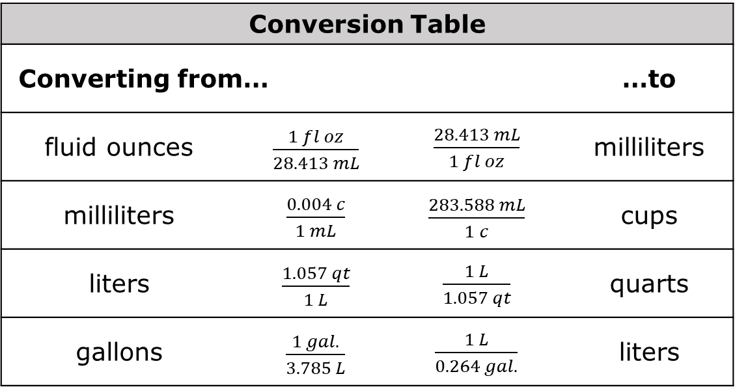
6.5.7 Wrap-Up: Ticket Out the Door
1. For each pair of liquid measurements, circle the conversion factor to use to convert from the measurement on the left to the measurement on the right.
Conversion Table
Converting from… |  |  |  | …to
fluid ounces | $\frac{1 fl oz}{28.413 mL}$ |  | $\frac{28.413 mL}{1 fl oz}$ | milliliters
milliliters | $\frac{0.004 c}{1 mL}$ |  | $\frac{283.588 mL}{1 c}$ | cups
liters | $\frac{1.057 qt}{1 L}$ |  | $\frac{1 L}{1.057 qt}$ | quarts
gallons | $\frac{1 gal.}{3.785 L}$ |  | $\frac{1 L}{0.264 gal.}$ | liters
volume 1, pg. 262

Slide 32
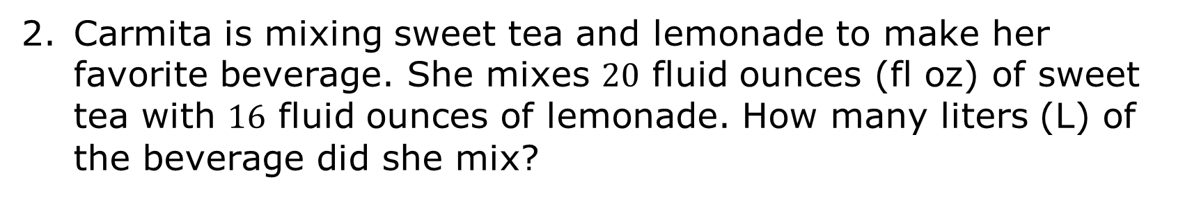
Carmita is mixing sweet tea and lemonade to make her favorite beverage. She mixes $20$ fluid ounces (fl oz) of sweet tea with $16$ fluid ounces of lemonade. How many liters (L) of the beverage did she mix?
volume 1, pg. 262

